Slide 1
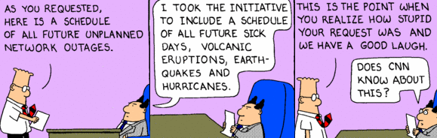
Strategic Management in a High Velocity World: Scenario planning
Russ Coff
Wisconsin School of Business, July 18, 2012

Slide 2
Agenda
Why planning often fails in a rapidly changing business environment.
Scenario planning as a tool to identify sources of uncertainty and anticipate outcomes.
Exercise: Razing the Ivory Tower. The challenge of using scenario planning effectively.
Decision trees and financial projections of different scenarios.
Next steps for your ideas.

Slide 3
My Background
Consulting:
  Strategy, Organization & Management
  M&A: Valuation of human assets for tax purposes
Teaching:
  Strategy (18 yrs BBA through Executives)
  Executive Education programs (M&A, Strategy)
Research:
  Competitive advantage
  How buyers cope in M&A involving human assets

Slide 4


Was this Good Luck or a Good Plan?

Slide 5

Does Strategic Planning Add Value?
Eenie, meenie, minie, mo... Top managers of big firms devote the bulk of their efforts to formulating strategy, though there is remarkably little agreement about what this is.
--The Economist
The Vision Thing: Spotting a “visionary” company is easy. The tricky bit is becoming one…
--The Economist
But it’s the #1 mgt tool & least likely to be dropped
--California Management Review
‘Visioning’ Missions Becomes Its Own Mission Stanford spent more than a year debating their mission. Now we know their goal is: “to be the leading academic school of management in the world in terms of its impact on management theory, thinking, practice and performance.”
--Wall Street Journal

Slide 6
What is a Business Plan?
How we get there
Where we are now
Where we want to be
Business Definition,
External/Internal Assessments
Vision Statement,
Strategy
Philosophy
Key Result Areas
Objectives
Goals
The mission of the School of Business … is to create ideas and alumni that have maximum impact on business.
The vision of the School of Business is to be internationally renowned for our ability to create knowledge and leaders.

Slide 7
Strategic Management Process
Internal Analysis (SW)
Value chain
VRINE
Corporate value
External Analysis (OT)
PESTEL
5 Forces
Game theory
Strategy
Arenas
Staging
&
Pacing
Economic
Logic
Vehicles
Differentiators
Implementation
Business plan
Resource allocation
Organizational design/∆
Strategy
People
Symbols
Structure
Rewards
Processes

Slide 8
Strategy Diamond
Arenas
Staging
&
Pacing
Economic
Logic
Vehicles
Differentiators

Slide 9
How to speed up the basic optimizing model?
Frame the problem
Identify decision criteria
Weigh each criterion
Identify alternatives
Evaluate alternatives
Implement best alternative

Slide 10
Fast Decision-Makers Don’t Cut Corners on Analysis
Fast Decision-Makers
Build multiple simultaneous alternatives
Seek advice from experienced counselors
Resolve conflict using consensus w/qualification
Integrate the decision w/ other decisions or tactics
Slow Decision-Makers
Develop one alternative, go to 2nd if the 1st fails
Seek advice haphazardly (e.g., unqualified people)
Resolve conflicts using consensus or deadlines
Consider the decision in isolation.
* Eisenhardt, K.M. 1989. “Making Fast Strategic Decisions in High-Velocity Environments.” Academy of Management Journal, 32(3): 543-576.

Slide 11
Predicting the Unpredictable with Scenario Planning
Identify assumptions about underlying sources of uncertainty.
Build scenarios by exploring interactions of the sources of uncertainty.
Estimate the likelihood of each scenario.
Identify trigger points when the early signs of each scenario should be visible.
Develop action plans for likely scenarios.
Watch for trigger points as you implement.
Identify trigger points when the early signs of each scenario should be visible.
Develop action plans for likely scenarios.
Watch for trigger points as you implement.

Slide 12
Agenda
Why planning often fails in a rapidly changing business environment.
Scenario planning as a tool to identify sources of uncertainty and anticipate outcomes.
Exercise: Razing the Ivory Tower. The challenge of using scenario planning effectively.
Decision trees and financial projections of different scenarios.
Next steps for your ideas.

Slide 13
Razing the Ivory Tower: Builderific
Vision: Build the tallest free-standing tower with one Builderific set in 3 min.
Planning: You get 10 min to organize your “firm” & plan the tower.
Develop plans for at least 2 scenarios.
No pieces may be assembled during the planning period.
Bring your “vision” to the front ASAP.
Start with all pieces back in the box.
Only use materials contained inside the box (not the box itself).

Slide 14
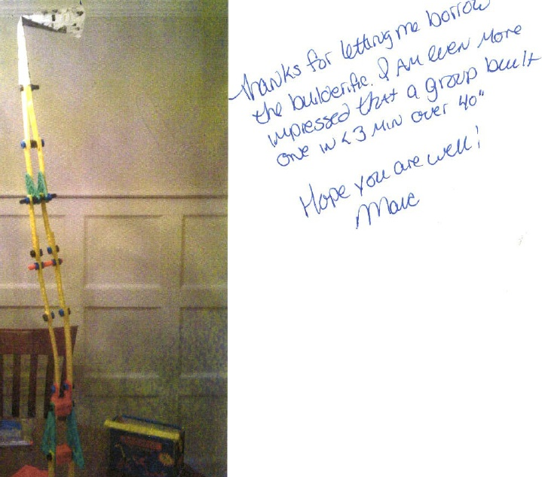
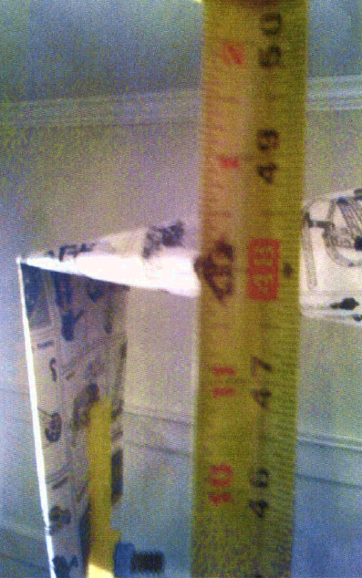
One Way to Hit 48”

Slide 15

Speed vs. Flexibility?

Slide 16
Builderific Discussion
Type of task: How is this like strategic planning in firms? Is this a fair analogy?
Planning process:
  Time on management vs. engineering/architecture?
  How did you develop your scenarios?
  Was there a systematic exploration of what might go wrong?
Unforeseen events?
  Did anything unexpected happen?
  How did you adjust?
  How can you plan effectively in this setting?

Slide 17
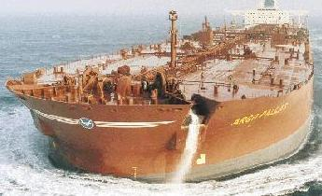
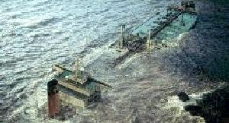
Competitive Advantage or Rivals Who Can’t Adapt?
It takes 5 miles to stop this thing
If you see ice 3 miles ahead...

Slide 18
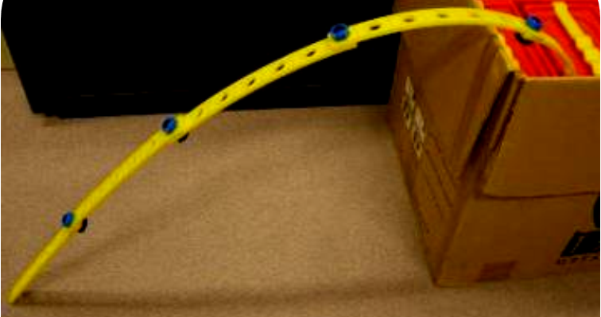
Predicting the Unpredictable?
What are the sources of uncertainty?
How might these interact to form scenarios?
What are the trigger points to identify the scenarios?
How can you prepare for the scenarios?

Slide 19

Building Scenarios 1: Group Process
Consensus:
Discuss until agreement is reached.
Brainstorming:
No idea editing/evaluation.
Delphi Technique
Collect ideas via survey
Compile results & return.
Ask members for new insights.
Repeat the cycle until a consensus emerges
Nominal Group Technique:
Individual written analysis before discussion
Take turns presenting ideas (no editing or evaluation yet)
Discuss & evaluate ideas
Individually rank ideas
Select best alternative
Devil's Advocacy
Assign people to challenge proposals and assumptions.
Include members who disagree.
Dialectic Inquiry
Subgroup develops alternative using different assumptions.
Debate alternative plans.

Slide 20
Building Scenarios 2: Common Traps
Paralysis. Where do we begin when facing the unknown. Start with several likely scenarios.
Communicating a vision with multiple scenarios appears non-committal. Analysis is still valuable.
Don’t dismiss low probability events since they do occur and can be highly impactful.
Illusion of control can result from the analysis – encouraging groupthink.
Interactions among variables lead to rich scenarios (e.g., mkt demand x rival response).
Source: Roxburgh (2009), The Use and Abuse of Scenarios. McKinsey Quarterly

Slide 21
Razing the Ivory Tower Take-aways
Planning hazards in a dynamic environment:
  Implementation. Resources don’t come together as was assumed.
  External changes challenge initial assumptions
  Rigidities result from “sticking to game plan.”
Coping strategies:
  Scenario planning: 1) Requires a clear signal to switch; 2) Can’t identify everything but may still help…
  Process interventions can help identify critical assumptions.

Slide 22
Agenda
Why planning often fails in a rapidly changing business environment.
Scenario planning as a tool to identify sources of uncertainty and anticipate outcomes.
Exercise: Razing the Ivory Tower. The challenge of using scenario planning effectively.
Decision trees and financial projections of different scenarios.
Next steps for your ideas.

Slide 23


Slide 24
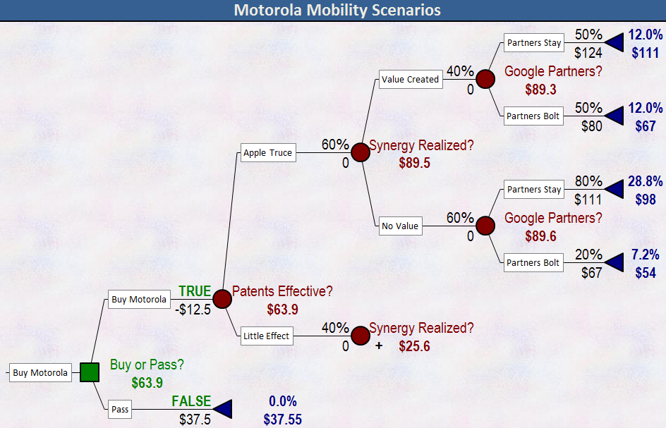
Scenarios Grow on Trees

Slide 25
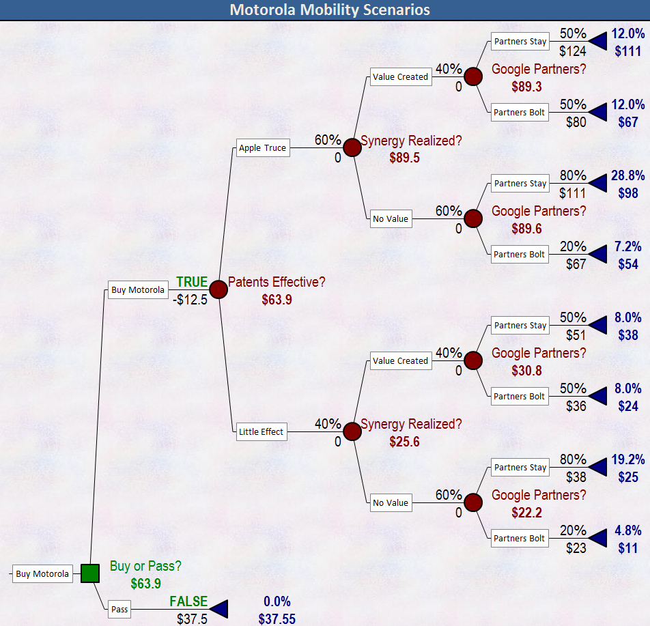
Scenarios Grow on Trees

Slide 26
Agenda
Why planning often fails in a rapidly changing business environment.
Scenario planning as a tool to identify sources of uncertainty and anticipate outcomes.
Exercise: Razing the Ivory Tower. The challenge of using scenario planning effectively.
Decision trees and financial projections of different scenarios.
Next steps for your ideas.

