Slide 1
Leading Strategic Change
Russ Coff
Randall Dunham
Wisconsin School of Business
July 19, 2011

Slide 2

Program Agenda
Why change matters. What roles do culture and change play in achieving business results at FMB?
FMB culture. What is the culture?
  Gaps. Are there gaps between the actual & ideal cultures?
  Culture change. How can we close the gap?
Managing the Change Process. Simulation exercise.
  Results: How did you do?
  Leverage: How and when to use change levers.
  New scenarios: How to adapt in different settings.
Stakeholder analysis and individual change. How will different people react to change?
Change at FMB. How can we apply what we have learned (culture, change projects, etc.)?

Slide 3

Below the Water Line of Culture
Norms
What behaviors are expected?
Values
What is important to us?
Beliefs
What leads to growth/performance?

Slide 4
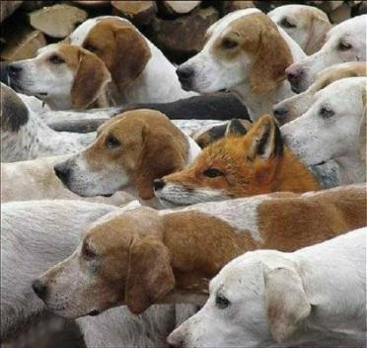
How Widely is the Culture Shared?
Dominant culture refers to the core values (beliefs & norms) that are shared by a majority of the organization’s members.
Subcultures are mini-cultures within a company, often defined by departments or geographical separation.
Strength of the culture refers to how widely shared the culture is (e.g., not whether it is good or bad)

Slide 5
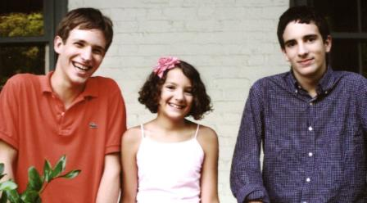
Examples of Artifacts
Artifact | Type | Norms | Values | Beliefs
Photos of family | SO | Work hard and late | Hard work. Meet client expectations | Work -> success
Photos of family | SO | Families? | Company is more important than personal lives | People won’t burn out. If they do, we can replace them
+
–

Slide 6

What is the WSoB Culture?
Breakout groups discuss artifacts reflecting strengths and opportunities for improvement:
  Share Artifacts:
    Role models ▪ Language
    Stories/Myths ▪ Rituals
    Symbol/Object ▪ Rites of Passage
  Analyze meaning of the artifacts in terms of:
    Norms for behavior
    Values we espouse
    Beliefs about what leads to success
Take turns presenting artifacts (with analysis) until a complete picture emerges.

Slide 7
What is the WSoB Culture?
Artifact | Type | Norms | Values | Beliefs
Artifact Types:
    RM: Role models ▪ SO: Symbol/Object ▪ RP: Rites of Passage
    S: Stories/Myths ▪ L: Language ▪ R: Rituals

Slide 8
Levers to Influence Culture
Convey
Desired
Values
People
Structure
Rewards
Processes

Slide 9
Levers to Influence Culture
Communication
Rites & rituals
Role models
Recruit
Select
Socialize
Remove
Centralization
Responsibilities
Roles
Convey
Desired
Values
People
Structure
Rewards
Processes
Work flow
Information flow
Policies & procedures
Formal/informal
Goal setting
Measurement

Slide 10
Stages of Change for Organizations
Mobilization Phase (Unfreeze)
Movement Phase (Change)
Sustain Phase (Refreeze)
Make the Case for Change Initiative
Build Momentum for Change Initiative
Institutionalize Change Initiative
Build the Organizational Capacity for Change
Preserve & Continue to Build Org Capacity for Change

Slide 11
Kotter’s 8 Steps of Leading Change
Establishing a Sense of Urgency
Mobilization
(Unfreeze)
Forming a Powerful Guiding Coalition
Creating a Vision
Communicating a Vision
Movement
(Change)
Empowering Others to Act on the Vision
Planning for and Creating Short-Term Wins
Sustain
(Refreeze)
Consolidating Improvements & Producing More Change
Institutionalizing New Approaches

Slide 12
Pulling it All Together: WSoB Culture
Do the proposed changes still make sense?
What would happen if we initiated the proposed changes in the wrong way?
What would be the optimal way to manage the proposed changes?
Breakouts: Take one “lever” & develop tactics to ready the org and implement changes.
Convey
Desired
Values
People
Structure
Rewards
Processes
Notes:
In groups – explore how each of the major levers would have to be implemented (start with flip charts developed earlier). How to ready the organization for each change…

Slide 13
WSoB Culture Takeaways
How important is culture as a source of competitive advantage for WSoB?
What aspects of the WSoB culture might be hard for a rival to duplicate?
What firms enjoy a competitive advantage due to the unique culture they’ve developed?
Convey
Desired
Values
People
Structure
Rewards
Processes
Notes:
In groups – explore how each of the major levers would have to be implemented (start with flip charts developed earlier). How to ready the organization for each change…

