Slide 1
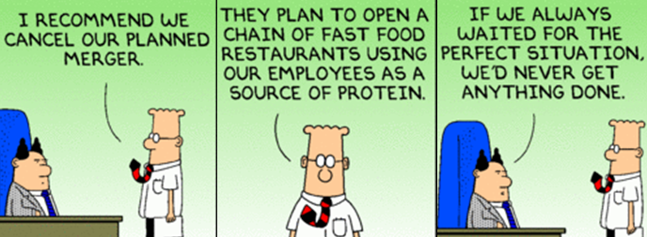
Competitive Bidding in M&A
11/2/11

Slide 2
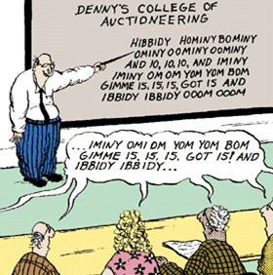
Bidding Wars under Uncertainty
9/29/09

Slide 3
Agenda
From corporate value creation modes to value capture in M&A
Bidding Hazards in M&A
  Exercise: Gourmet Adventures
  What strategic factors drive the risk of winners’ curse?
  How can you manage the process to minimize the risk of being cursed?

Slide 4
Elements of Strategic Management
Internal Analysis (SW)
Value chain
VRINE
Corporate value
External Analysis (OT)
PESTEL
5 Forces
Game theory
Arenas
Staging
&
Pacing
Economic
Logic
Vehicles
M&A, 4C
Differentiators
Implementation
Business plan
Resource allocation
Organizational design/∆
Strategy
People
Symbols
Structure
Rewards
Processes

Slide 5
Logics for Value Creation
Operational Economies of Scope: Combine value chains to lower costs/build sales (Loss if units were spun?)
Core Competencies grant sustained advantages (Must be unavailable if units were spun – VRINE)
Vertical Integration: Internal supplier/buyer relationship (Why wouldn’t an alliance work?)
Internal Capital Market: Funnel cash to promising units (Why do external capital markets fail?)
Discipline: Break up, restructure, or fix inefficient targets (Why didn’t target management do this?)
Acquisition Competence: Information advantage to buy low & sell high (Why is the target mispriced?)

Slide 6
5 Types of Successful Mergers
Improve target’s operational performance.
Consolidate to remove excess industry capacity (lowers costs as plants are shuttered; captures revenue).
Accelerate market access for products (buyer or target)
Buy capabilities faster/cheaper than developing them.
Pick winners & help them develop their businesses.
Harder Strategies:
  Roll-ups: Consolidate fragmented markets to achieve scale
  Rivalry reduction through consolidation
  Transformational merger
  Buy cheap
*Goedhart, Koller, & Wessels, 5 Types of Successful Acquisitions, McKinsey Q, 2010

Slide 7


Case Example: Jack & Me
“People say, Jack, how can you be at NBC, you don't know anything about dramas or comedies...Well, I can't build a jet engine, either. Our job at GE is to deal with resources--human & financial. The idea of getting great talent, giving them all the support in the world, and letting them run is the whole philosophy of GE, whether it's in turbines, engines, or a network.”
Fortune, 1997

Slide 8
GE/NBC Acquisition Scenario
The Deal: GE buys RCA for $6.4 billion – a 71% bid premium. The intent is to build NBC into a new line of business.
Operational improvements: Double the operating margin from 13% to 26% (industry avg. = 19%).
  Layoff 40% of the work force
  6 Sigma programs to improve quality & efficiency
  Tighter financial controls and cost cutting programs
Revenue Growth: 60% increase
  Expand into cable & movies
  Overseas media markets & cable channels
  Syndication of existing content library

Slide 9
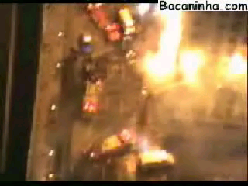
Winning at Bidding Wars

Slide 10

Gourmet Adventures
The target has 3 restaurant chains:
  Quarters is a chain of upscale steak houses.
  Nickels are moderately priced family restaurants.
  Pennies Pizza serves college campuses.
Valuation:
  The firm (jar) is 500 ml in size
  9 ml of quarters generates $2.00 of NPV
  12 ml of nickels generates 50¢ of NPV
  20 ml of pennies generates 25¢ of NPV
  Air = Corp overhead (Worthless to buyer)
  Rules: Don’t lift or shake the company!

Slide 11
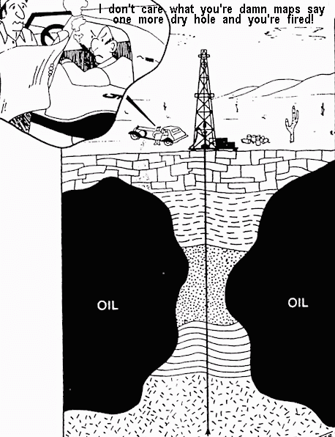
The Winners’ Curse in Oil

Slide 12
The Winners’ Curse
1. Bidders develop estimates of the target’s value based on imperfect information.
2. Firms submit bids based on their evaluations.
3. Estimates are distributed around the true value.
4.Winner’s bid is above the true value -- to win is to be cursed.
Distribution of Estimates
}
“winner”
Actual Value
Distribution of Bids
}
5. Responding. If bidders adjust down to avoid overbidding, the distribution of bids shifts.
“winner”
Actual Value

Slide 13

Gourmet Adventures Debrief
When is the risk of the winner’s curse greatest?
  Uncertainty/variation in estimates
  Number of bidders
  Information disadvantages relative to rival bidders
How can we manage this process to avoid the winner’s curse?
  How did you decide how much to shade your bid in the exercise? How can you be more rigorous?
  What are the drivers of variation in M&A valuations? How can one be more rigorous here?

Slide 14
Why Buyers Pay a Premium Over the Target’s Market Value?
Target shareholders realize synergies:
  Acquisition competence: Buyers have information the market lacks (#6)
  Discipline: Poor target company mgt (#5)
  Synergy (#1-4: operational economies, core competence, VI & internal capital markets)
Managerial Hubris hypothesis:
  Bid premia are associated with CEO media praise & CEO “self importance” (CEO/COO pay)
  Negative abnormal returns for buyers when they buy unrelated human-asset-intensive targets.

Slide 15
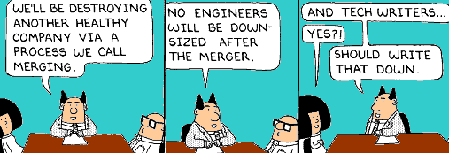
Coping with Strategic Uncertainty & The Winners’ Curse
2/11/09

Slide 16
M&A Stock Mkt Returns
Target
Buyer
Source: Bradley, Desai, & Kim, 1988

Slide 17
What Determines the Risk of Winner’s Curse?
Number of bidders. More bidders increases the risk that one will represent a statistical tail.
Variance in estimates. The greater the variance, the longer are the tails and the greater the risk that the winner will be higher.
Distribution of information. Uneven distribution contributes to the curse if the values among bidders are correlated.

Slide 18
Information Structures in Auctions
Perfect information: The true value of the asset is known – bidders stop at that point.
Common value: There’s a single true value for the item (across bidders) but it’s unknown.
Affiliated value: Bidders have distinct uses for the asset but they are correlated with each other.
Private value: Bidder has a unique value for the asset (e.g., complementarities). Often rivals cannot compete…
Curse
Curse
Curse
Curse

Slide 19
Gourmet Adventures Debrief
When is the risk of the winner’s curse greatest?
  Uncertainty/variation in estimates
  Number of bidders
  Uneven distribution of information among bidders
How can we manage this to avoid being cursed?
  How did you decide how much to shade your bid in the exercise? How can you be more rigorous?
  What are the drivers of variation in M&A valuations? How can one be more rigorous here?

Slide 20

Gourmet Adventures
Thought Experiment
What strategic factors drive the risk of the winner’s curse?
  Diversified targets
        .
        :

Slide 21
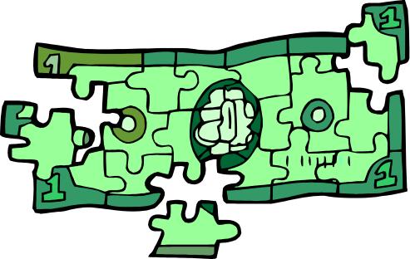
Who captures the value of synergy?
Firm Value of target
Target : MicroDesign (stand alone NPV) $500M
Buyer 1: KKR (no synergies) $500M
Buyer 2: Sega (vertical integration) $550M
Buyer 3: Sharp (leverage expertise) $600M

Slide 22
Anticipating Integration Dilemmas at Pinnacle
Corporate Headquarters
Warehouse Mgt Software
Transportation Mgt Software?
Other Divisions
Firm Infrastructure
Human Resource Management
Technology Development
Procurement
Firm Infrastructure
Human Resource Management
Technology Development
Procurement
Firm Infrastructure
Human Resource Management
Technology Development
Procurement
Inbound Logistics
Production
Sales
Service
Inbound Logistics
Production
Sales
Service
Inbound Logistics
Production
Sales
Service
Strategy
Develop & cross-sell a software “suite”
Spin off the two divisions in an IPO

Slide 23
Writing off Human Assets in an Acquired Brokerage Firm
90% of NPV due to high producers (top 5% bring 1/3 of sales). Lose $ on low producers.
High producers take 95% of their business if they move to a rival (e.g., separate from “goodwill”).
The NPV of brokers ranged from $6M - $30M -- about 1/3 of the acquisition price.
Tax break of $3M - $15M due to the amortization expense (50% tax bracket).
Impact on uncertainty about the target’s value?

Slide 24
Post Acquisition Integration and Shareholder Value
RISK FACTORS
Uncertainties in Integrating Business Operations and Realizing Enhanced Earnings
“The merger involves the integration of two companies that…have different corporate cultures.... No assurance can be given that Travelers and Citicorp will be able to integrate their operations without encountering difficulties including the loss of key employees and customers. …In determining that the merger is in the best interests of Travelers and Citicorp… Directors considered that enhanced earnings may result from the consummation of the merger, including from cross marketing opportunities. However, there can be no assurance that any enhanced earnings will result from the merger.”
--Prospectus sent to Travelers & Citicorp shareholders (6/18/98, p.15)

Slide 25
Gourmet Adventures
Thought Experiment
How can you manage each of the following to reduce the risk of the winner’s curse?
  Diversified targets
  Synergies with bidders
  Foreign operations
  Human assets
  Intellectual property
  Other strategic assets?

Slide 26
When can buyers capture the value of synergy?
When there’s only one bidder? Maybe…
  Low bids draw in rivals -- threat may be enough.
  Preemptive bids keep rivals out but target gains.
Unique synergies allow buyers to capture value – next closest bidder can’t realize comparable gains.
Timing may put rival bidders at a disadvantage:
  Hostile? 2nd bidders may be viewed as hostile (overcome lockup agreements). Need cooperation to create synergy.
  Preemption: If transaction is announced as a “done deal” others may lack time to bid (steering the Titanic...).

Slide 27
Reducing the Risk of the Winner’s Curse
Type of target:
  What types of assets should firms go after?
  How can firms identify and/or generate “unique” value (complementarities)?
Valuation. How to reduce variance in valuations due to strategic uncertainty?
Competition. How to discourage or reduce the risk of rival bidders?

Slide 28
Managing the Acquisition Process to Avoid Being Cursed
Search criteria for targets
Initial target screening
Pre- Acquisition
Approach/Letter of Intent
Formal bid
Due diligence
Negotiating the Deal
Implement changes linked to value creation strategy
Post Acquisition

Slide 29
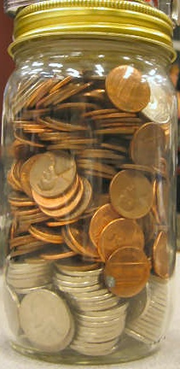
Take-Aways from Gourmet Adventures
Drivers of the winners curse: Sources of uncertainty and volatility in valuations.
  Diversified Targets
  Synergy
  Human Assets
  Country Risk
  Most sources of strategic value!
Action Implications. Knowing about winners’ curse isn’t enough:
  Emphasize private/unique value
  Information strategies to reduce variance.
  Tie up target so rivals don’t emerge.
Notes:
29

Slide 30
Alignment and Corporate Strategy
GOVERNANCE
BUSINESSES
Resources & Capabilities
ORGANIZATION
CORPORATE ADVANTAGE
Source: Adapted from Collis & Montgomery, Corporate Strategy

Slide 31
Strategies Serve Different Stakeholders
Reduce
Risk
Rapid Growth
Internal capital market
Share
Infra-structure
Market Power
Core Compe-tencies
Favors the Company’s Managers
Favors the Company’s Shareholders
Least Power to Create Value/Least Defensible
Most Power to Create Value/ Most Defensible
HP
“Our strategy is to offer products, services and solutions that are high tech, low cost, and deliver the best customer experience. No other company has the portfolio, people & expertise to deliver on all three”

Slide 32
What is Corporate Value?
A Shareholder Perspective
Corporate/Multi-Business Form
Corporate Headquarters
Division 1
Division 2
Division 3
Division 4
Market (Shadow) Form
Firm 1
Firm 2
Firm 3
Firm 4

Slide 33
Anticipated Integration Plan
Value Creation Opportunities | When?
Cut Costs: Increase Op margin from 13% to 26%
Layoff 40% of the work force
6 Σ programs to improve quality/efficiency
Tight financial controls & cost cutting programs
Revenue: 60% Growth
Expand into cable & movies
Overseas media markets & cable channels
Syndication of existing content library

Slide 34


Case Example: Jack & Me

Slide 35



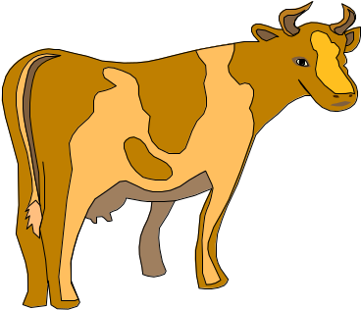

Tools That Don’t Work 2: McKinsey/GE Matrix
Competitive Position
Real Estate
Brokerage
Banking
Industry Attractiveness
ZZZ
Insurance
Credit
Retail

Slide 36
Intelligent Clean Room: Best Practices
Overlap in valuation & implementation teams.
Formally incorporate time-delay calculations in valuation.
Define synergies around activities not functions (e.g., supply chain savings not purchasing).
Re-recruit the best from both firms early on.
Clear measurable goals for value creation.

Slide 37
Take-Aways from GBS Acquisition
Evaluating synergies & gains:
  Value creation strategy must be clear up front (before considering specific targets).
  Sensitivity analysis on implementation (timing of gains, etc.) to determine bid range.
    Involve operations people up front to assess.
    Unique synergies & bidding wars: Identify firm-specific value that rivals cannot realize.
Long-term acquisition program:
  Exit strategy linked to value creation.
  New core competence: How to assess value…

Slide 38

GE Managers in Action

