Slide 1
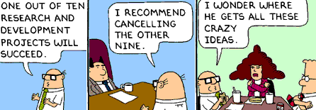
Strategic Luck:
Investing in long-shot opportunities
11/28/12
( Please be sure to take a penny ;-)

Slide 2
Today’s Agenda
Generating your own luck: The problem of strategic investments under uncertainty
Modeling investment decisions
  Staging of investment decisions to mitigate downside risk
  Moving from staging to real option analysis
  Managing portfolios of real options
Organizational dilemmas from portfolios of strategic investments
  Managing change
  Escalation of commitment
Notes:
2

Slide 3
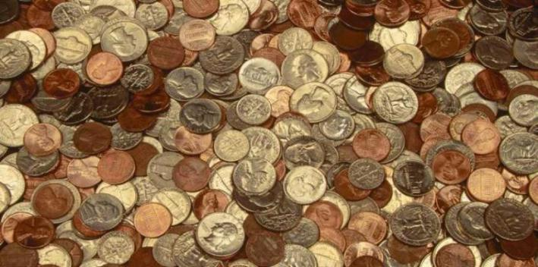
Exercise: Heads Up!
Initially, everybody stands.
Flip coins when told, all at the same time.
Do not look at the coin until told.
If you flip a head, remain standing.
If you flip a tail, sit down.
Winner (last one standing) gets all the $

Slide 4
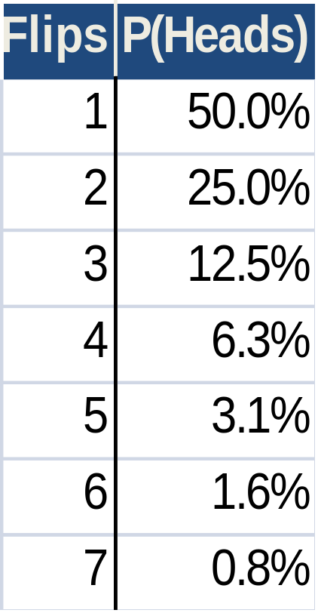

Proposition: Success in technological innovation is all luck.
Realistic simulation? Does the exercise simulate the innovation process for organizations & industries?
Selection bias. We often only study “winners.”
  In search of excellence…
  Stock scam…
Few repeat innovators. Most major innovations come from outsiders.

Slide 5

50/50 is better than one can expect for many innovations: How do most analytical tools handle this?
19% Chance of Phase III success & FDA approval

Slide 6
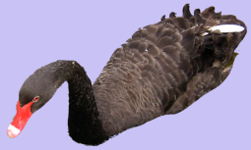
Hit, Miss, Error: Investing in Uncertain Technologies
Actual
Outcome
II
False −
Success
Failure
I
False+
Drop
Pursue
Predicted
Judgment
Adapted from Zur Shapira (1995) Risk Taking: A managerial perspective

Slide 7
Investment Decision Errors
Type I: “White Elephants” (false accepts).
Type II: “Missed Opportunities” (false rejects).
Type II errors are rarely punished. Xerox invented PCs, LANs, GUIs, & laser printers.
Will customers tolerate errors? How does zero error tolerance match with creativity?
Will shareholders tolerate errors?

Slide 8
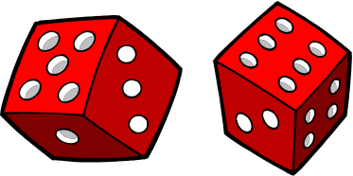
Investment Decisions as Pure Luck
Actual
Outcome
Success
Failure
Predicted
Drop
Pursue
Judgment
Adapted from Zur Shapira (1995) Risk Taking: A managerial perspective

Slide 9
A Highly Predictive Model or Just Avoiding Risky Decisions?
Actual
Outcome
Success
Failure
Predicted
Drop
Pursue
Judgment
Adapted from Zur Shapira (1995) Risk Taking: A managerial perspective

Slide 10
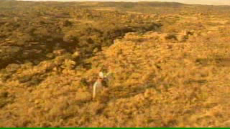
Wish you could get a brief glimpse of the future?

Slide 11
Innovation Investment Challenges
Analytic/Quantitative Challenges
  Uncertainty: Speculative assumptions lead to excessive conservativism or unrealistic optimism – sensitivity?
  Risk: Raising hurdle rates (in DCF) means sticking to low risk/low return business models. Real options?
Organizational Challenges
  Must suspend learning for radical innovations.
  Poor exercise decisions: Promising ideas may be rejected as too risky or firms may continue to plow money into bad projects in the face of uncertainty
  Failure: What happens to champions of dead projects?
  Corporate logic: How should new businesses be linked to existing businesses?
Behavior
Outcome

Slide 12
Today’s Agenda
Generating your own luck: The problem of strategic investments under uncertainty
Modeling investment decisions
  Staging of investment decisions to mitigate downside risk
  Moving from staging to real option analysis
  Managing portfolios of real options
Organizational dilemmas from portfolios of strategic investments
  Managing change
  Escalation of commitment
Notes:
12

Slide 13
NPV & Investment Under Uncertainty
Traditional NPV Approach
Should we invest in commercializing a new but uncertain technology?
Assume:
  * $100M technology investment
  * 50% probability of $200M NPV return
Analysis:
  -100 + .5(200) = 0
Rule: No reason to take on the risk!
Question: Will we know more in 1yr?

Slide 14

Uncertainty Clarifies Over Time…
Profit/Loss Profile
Greater
Profits
Most likely
Value (NPV)
X
X
X
X
Worse
Losses
Time

Slide 15
Assessing Real Option Value
.8
Success
($182M)
.5
Commercialize
(-$91M)
$36M
$17M
Pilot Capability
(-$10M)
Failure
($0M)
.2
Abandon Project
.5
.5
Success
($200M)
$0M
Tech Decision
Commercialize
(-$100M)
Failure
($0M)
.5
Abandon Project
Option price= $10M
Option value=$46M
Option price =$10M
Option value=$27M

Slide 16
Types of Real Options
Option Type | Important in, e.g., | Trigger
Abandon/put | Cash out startups; Capital-intensive industries | Respond to bad news
Switch outputs or inputs | Consumer electronics, Electric power
Defer commitment | Natural-resources; R&D (pharma, etc.), patents
Expand scale or scope | Venture capital; Fashion apparel; JV→M&A | Respond to good news
Growth | Technology platforms; core competencies
Notes:
16

Slide 17

Dell’s Switching Option
Dell faced uncertainty over which type of battery to use in its laptops (NiHi or the new LiOn).
  If LiOn works (p=60%), NPV = $600 Million
  If LiOn fails (but they commit), NPV = $250 Million
  If they stick with NiHi, NPV = $500 Million
Two ways to defer commitment (retain flexibility):
  Dual development: Cost = $3 Million
  Overdesign (either battery works): Cost = $10 Million
Is it worth the added cost to be able
to switch battery technologies later?
Notes:
17

Slide 18
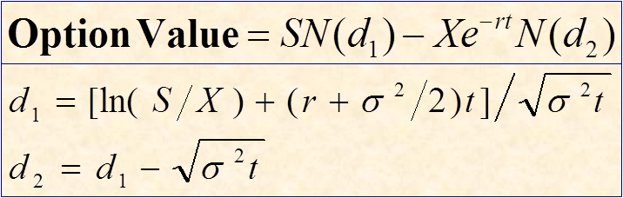
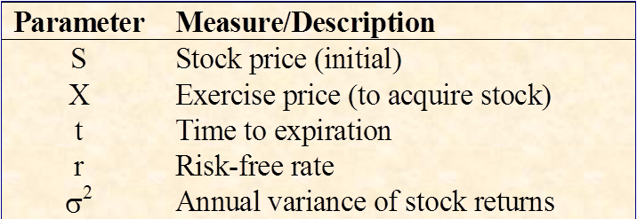

Black-Scholes Option Valuation

Slide 19
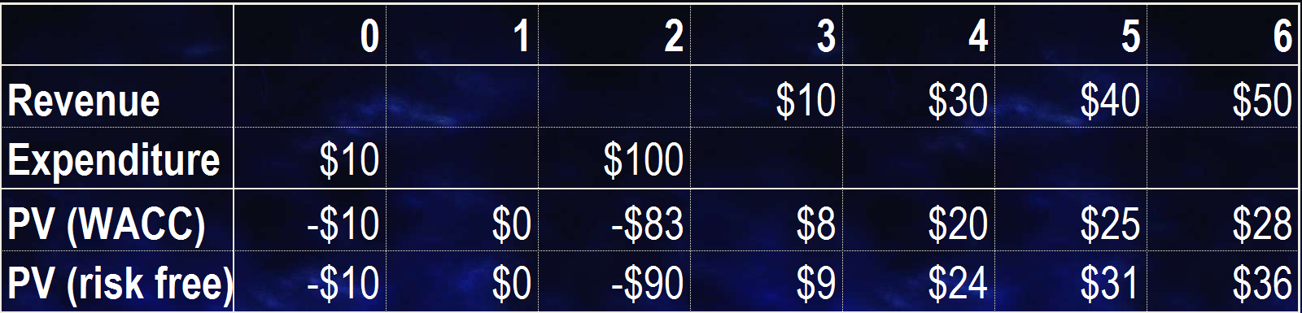
Calculating Option Parameters
t
X
S = $81M
r
NPV (@10%) = ($12M); Risk free rate = 5.5%
Luehrman approach parameters
  S = Current value of a project’s underlying assets
  X = Expenditure required to acquire project assets
  t = Time before the exercise decision is made
  r = Risk free rate
  σ = Standard deviation on project returns (?)
Notes:
19

Slide 20
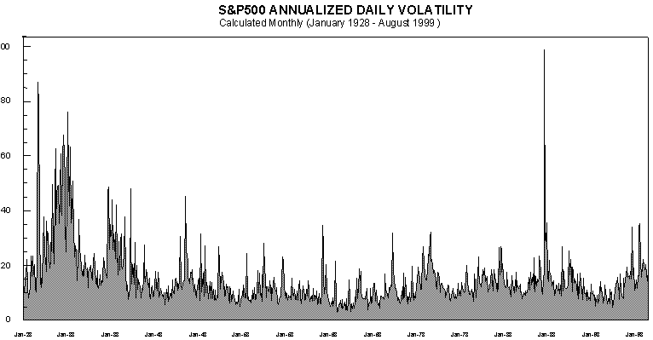
Some Volatility Reference Points
1928 1933 1938 1943 1948 1953 1958 1963 1968 1973 1978 1983 1988 1993 1999
Forward looking/Implied volatility estimates:
Genzyme: ≈ 32%
Alexza Pharmaceuticals: ≈ 110%
Crucell NV: ≈ 156%

Slide 21
Today’s Agenda
Generating your own luck: The problem of strategic investments under uncertainty
Modeling investment decisions
  Staging of investment decisions to mitigate downside risk
  Moving from staging to real option analysis
  Managing portfolios of real options
Organizational dilemmas from portfolios of strategic investments
  Managing change
  Escalation of commitment
Notes:
21

Slide 22

Real Options in Real Organizations: Predicting outcomes
Time Frame Ambiguity
Pressure to delay decision
Social capital/ reputation is key
Outcomes
Escalation
Kill golden goose
Persistent Uncertainty
Org Form
Integrate/ Isolate
3M
Integrated: Champion w/strong ties ⇨Escalation
Isolated: Champion w/weak ties ⇨Kill good projects
*Adapted from Coff & Laverty, 2001, 2007

Slide 23
Mitigating the Risk of Bias
Intervention | Type I Bias to Escalate | Type II Bias to Kill
Org Design/ Structure | Isolate option to minimize social ties | Integrate: actively build cross-unit ties
Portfolio composition | Substitutes: credible commitment to “kill” | Complements: “Team” effort
Decision process | Impartial/External: University/Adv. board | Involve people with direct ties
Timing of decision | Move exercise decision forward | Push exercise decision back
*Adapted from Coff & Laverty, 2001, 2006

Slide 24
Bottom line on Real Options
Does an option make sense? What can you learn by delaying full commitment? At what cost?
Methods. Choose one that fits w/available info, culture, and decision-makers’ styles.
Tool | Strengths | Limitations
Decision Tree | Intuitive & Superior to DCF | May not account for risk properly Some option value missed
Black Scholes | Rigorous & intuitive for some… | Hard to measure parameters (e.g. σ) Ignores some information
Management challenges. Must tailor org systems (structure, incentives, etc.) to make it work.
Notes:
24

