Slide 1
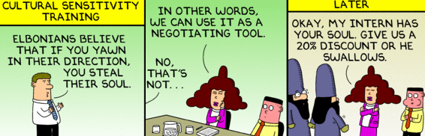
Culture Artifact Hunt Exercise
10/21/16

Slide 2
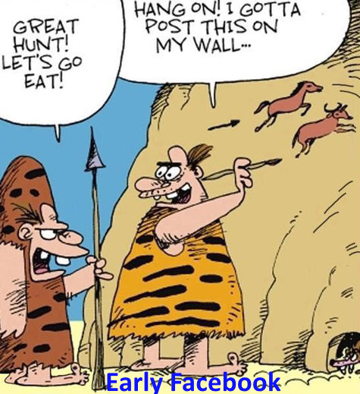

Artifacts: What Makes Culture Tangible?
Artifact | Norms | Values | Beliefs
Role model behavior (1)
Ceremonies/Rites of passage (2)
Stories or Myths (3)
Rituals or routines (4)
Symbols or Objects (5)
Physical Space (6)
Language/Formal Statements (7)
Schein, p.22

Slide 3
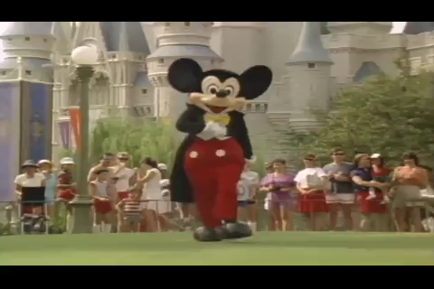
Cultural Artifacts @ Disney

Slide 4
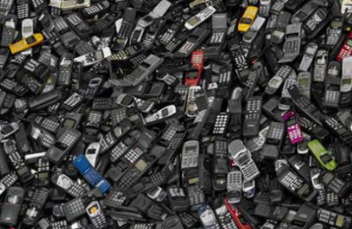
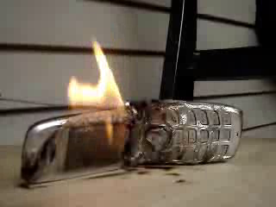
Symbols: Samsung Burned $50M of Phones

Slide 5
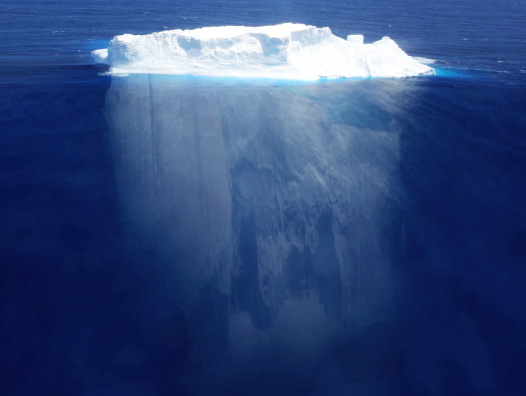
Below the Water Line of Culture
Norms
What behaviors are expected?
Values
What is important to us?
Beliefs
What leads to success?

Slide 6
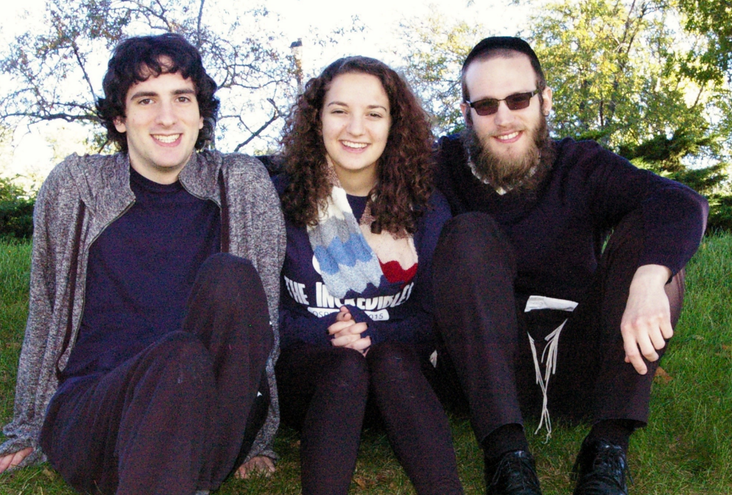
Examples of Artifacts
Artifact | Type | Norms | Values | Beliefs
Photos of family | SO | Work hard and late | Hard work. Meet client expectations | Work -> success
Photos of family | SO | Families? | Company is more important than personal lives | People won’t burn out. If they do, we can replace them
+
–

Slide 7
What is the EMBA Culture?
Breakout groups discuss artifacts reflecting strengths and opportunities for improvement:
  Share Artifacts:
    Role model behavior ▪ Symbols or Objects
    Ceremonies/Rites of passage ▪ Physical Space
    Stories or Myths ▪ Rituals or routines
    Language/Formal Statements
  Analyze meaning of the artifacts in terms of:
    Norms for behavior
    Values we espouse
    Beliefs about what leads to success
Take turns presenting artifacts (with analysis) until a complete picture emerges.

Slide 8
What is the EMBA Culture?
Artifact | Type | Norms | Values | Beliefs
Artifact Types:
    RM: Role model ▪ SO: Symbols or Objects ▪ R: Rituals/routines
    C: Ceremonies/Rites ▪ PS: Physical Space ▪ L: Language
    S: Stories or Myths

Slide 9
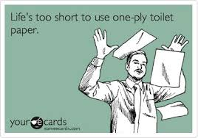
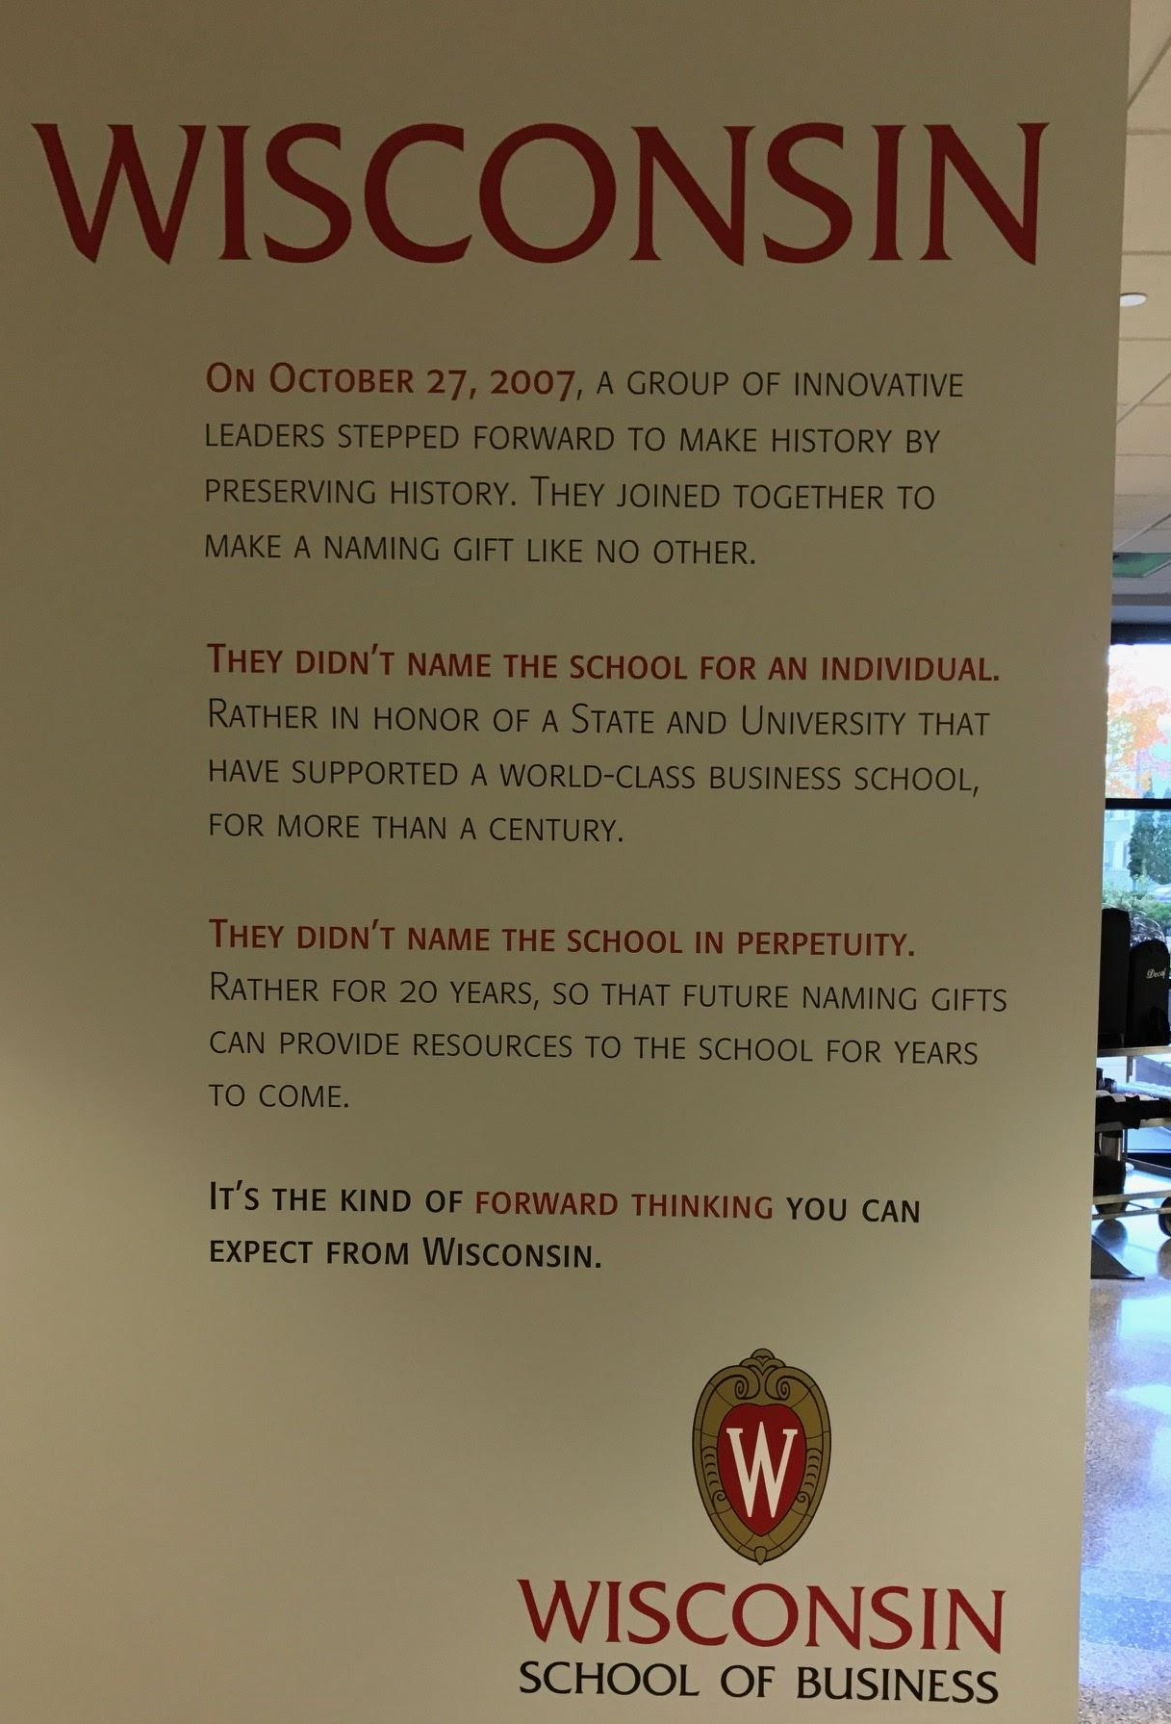
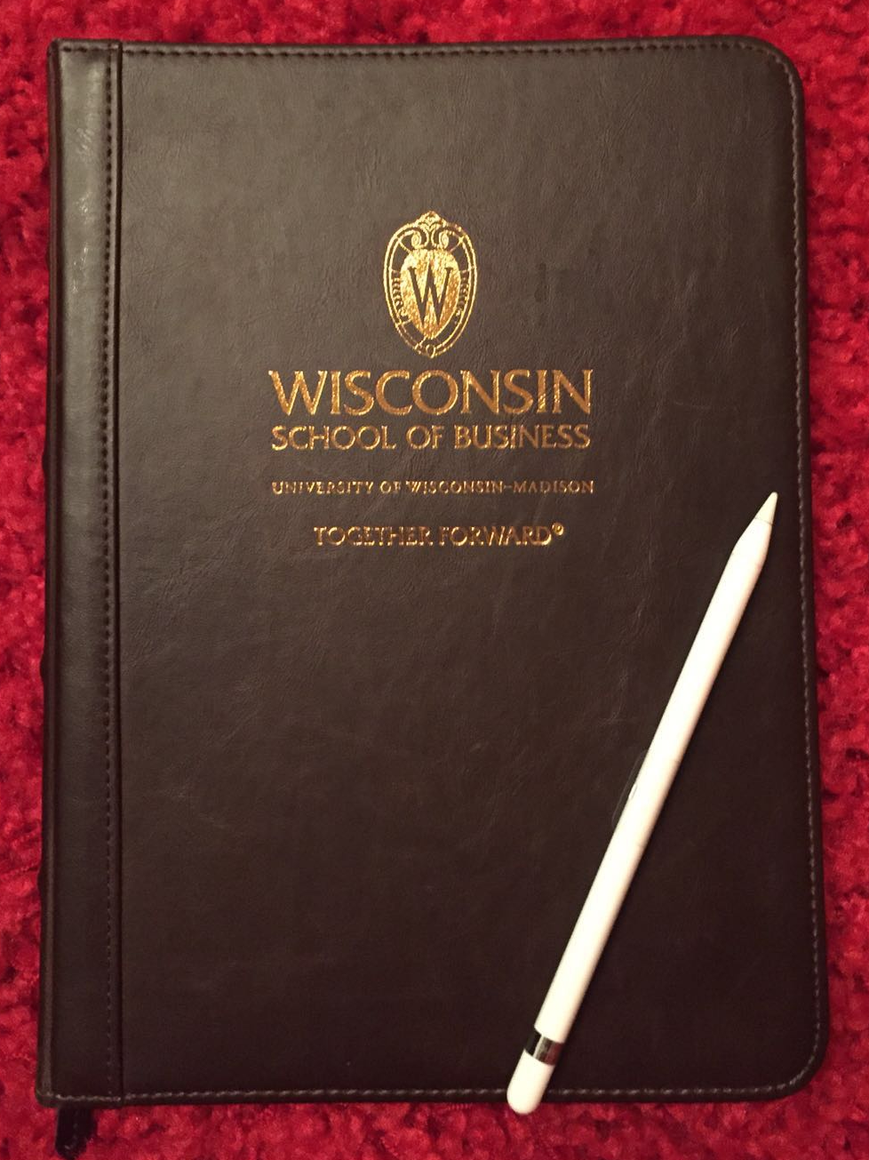
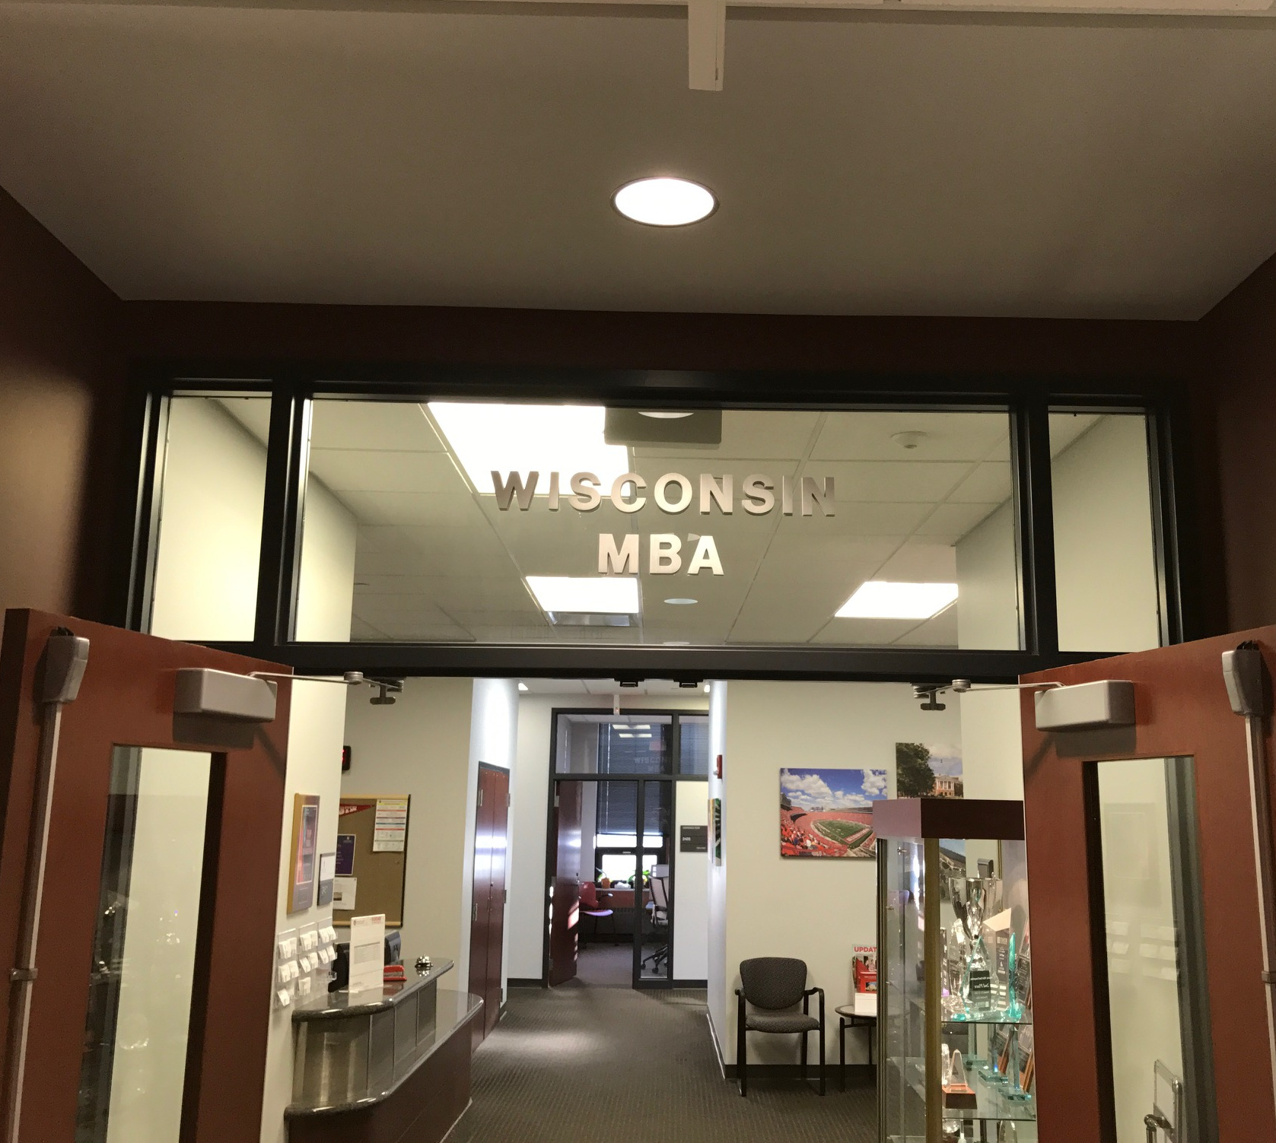
Team5 Purple Artifacts
R/SO
SO
S
PS

Slide 10
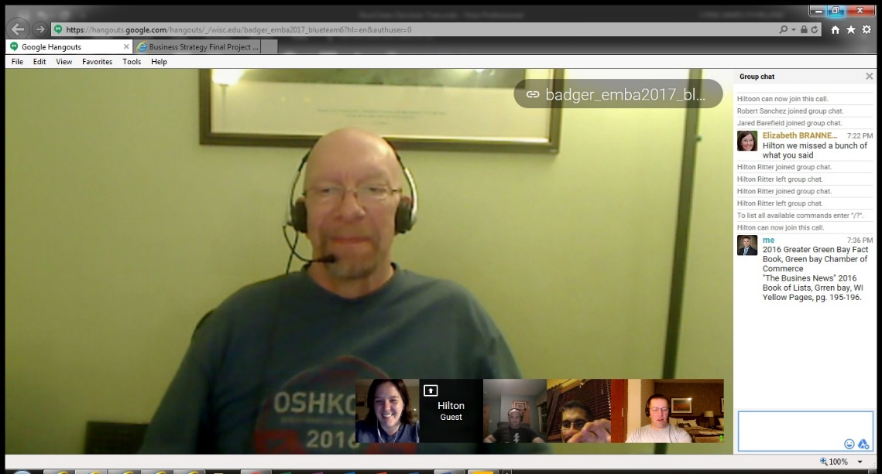
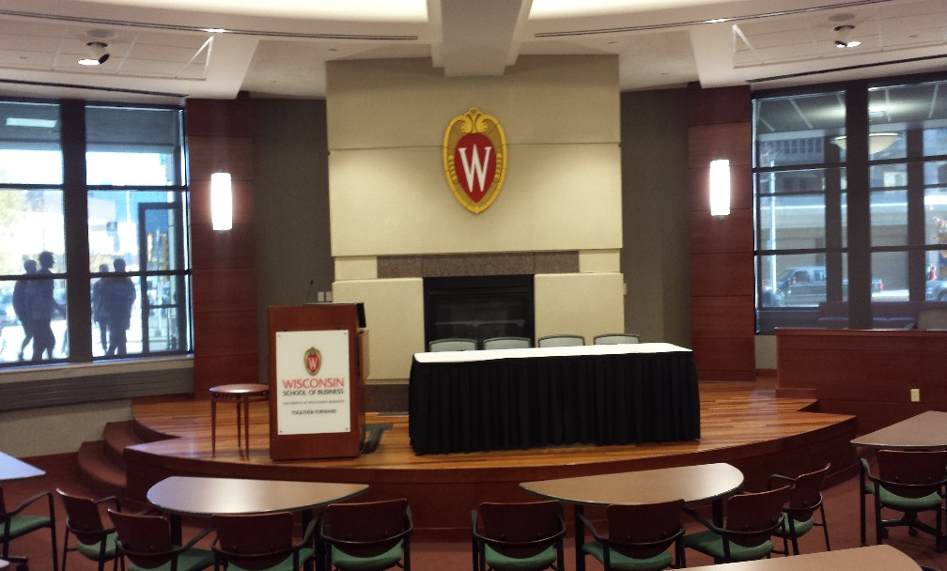
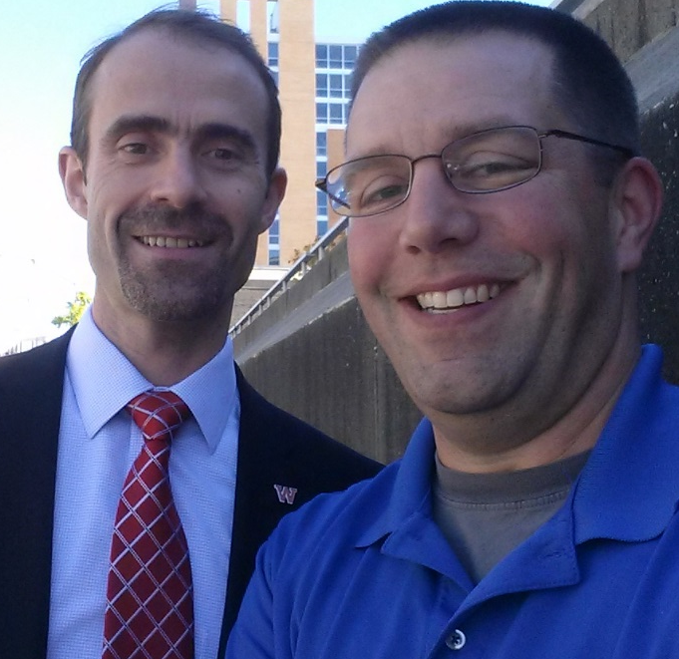
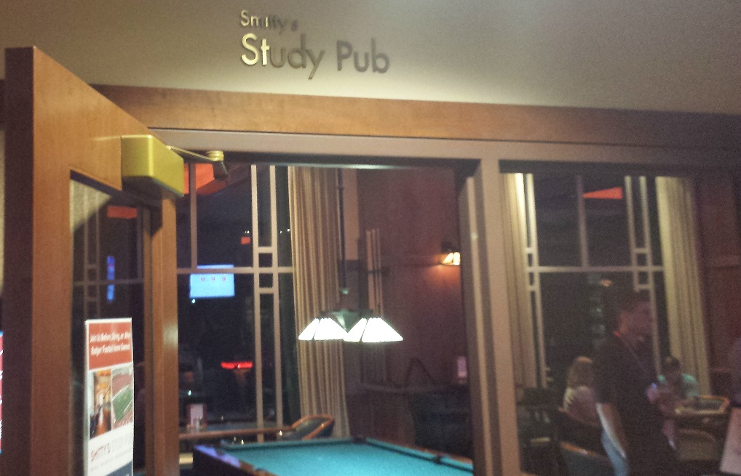
Team6 Blue Artifacts
R
PS
RM
R

Slide 11
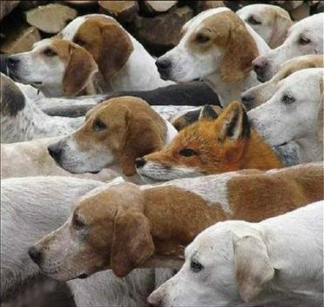

How Widely is the Culture Shared?
Dominant culture refers to the core values (beliefs & norms) that are shared by a majority of the organization’s members.
Subcultures reflect variance in culture within a firm, often defined by departments or geographical separation.
Strength of the culture refers to how widely shared the culture is (e.g., not whether it is good or bad)

Slide 12

When the old rules suddenly don’t apply…

Slide 13
Levers to Influence Culture
Communication
Create artifacts (Rituals, Role models, space…)
Strategy
Recruit
Select
Socialize
Remove
Centralization
Responsibilities
Roles
People
Structure
Symbols/
Artifacts
Rewards
Processes
Work flow
Information flow
Policies & procedures
Formal/informal
Goal setting
Measurement

Slide 14
Levers to Influence Culture
Strategy
People
Structure
Symbols/
Artifacts
Rewards
Processes

Slide 15
Change Management Steps
Change
Empower key stakeholders:
  Who will influence outcomes?
  Find gaps between desired & realistic responses
  Get buy in to close gaps
Plan for short-term wins
Unfreeze:
Create a sense of urgency
Powerful guiding coalition/ Vision for change
Refreeze:
Accelerate & solidify (Star)
  Rewards
  Structure

Slide 16

Practical Implications
Global strategy (Business model adaptation, market entry modes, global work assignments)
Competitive advantage (coordination & creativity/innovation)
Vehicles/Interfirm strategies (M&A/Alliances/JVs)
Next steps?
  Work
  Teams/Class
  Families
  Other?

Slide 17
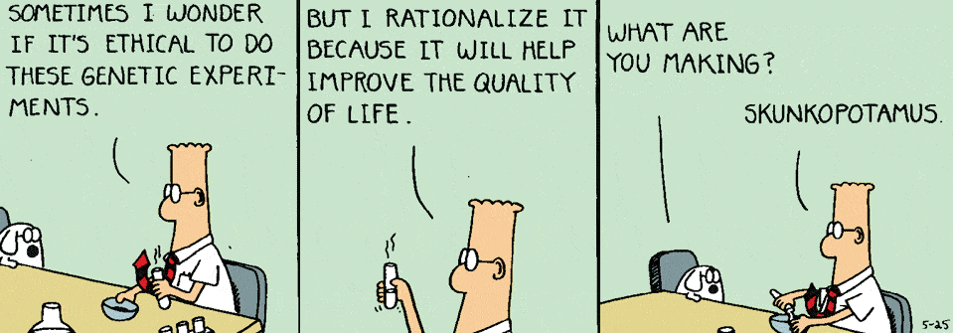
Ethics and Strategy
10/21/16

Slide 18
A Few Ethical Dilemmas from our Cases
Genzyme
  Are we gouging Gauchers patients (Cerezyme price)?
  Should we test if Synvisc1 is better than Synvisc3?
eHarmony
  If better matches are due to high prices (etc.) rather than the algorithm, do we need to tell customers?
Cadbury
  Are revenue synergies just a ruse to manipulate employees into cooperating?
Nintendo/Pokémon GO
  Should they tell investors how much flows to Nintendo?
  How will they use people’s data?
Notes:
18

Slide 19
Debate: A deeper dive into chocolate
Cadbury: Expand production in low cost plants that don’t adhere to US safety/building/wage standards?
Write down your initial position
Pros of expanding/moving production?
Cons of expanding/moving? Who might be hurt?
How do we weigh the points raised?
Write down your final position. Did it change?
How do the course tools help us w/this problem?

Slide 20
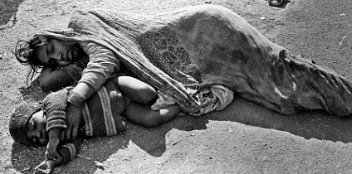
Union Carbide Bhopal India Disaster
Union Carbide pesticide plant leak exposed 600,000 people to methyl isocyanate (MIC) gas (12/3/84).
Official death toll of 3787 – estimates up to 16,000. 558,125 injuries (3,900 were severe & permanent)
Company settled for $470M ≈ $29k/human life lost.
Plant was locally sourced & built to local standards

Slide 21
Process for Ethical Decision-Making
Understand the Situation:
  Context: Who are stakeholders? What’s the setting?
  Decision Process: How to decide? Who to involve?
  Standards of conduct: Would alternatives violate professional, legal or ethical standards?
Consequences: What are possible outcomes for each stakeholder?
Character/Virtue: What will lead to success over time? What can I live with?
Rationalization: Can I defend the decision if it were public? If I were on the losing side?
Harris, Parmar & Wicks. 2015. Ethical Business Decisions: The Framework. Darden Ideas to Action

Slide 22
Culture & Ethical Dilemmas in the News
Former Wells Fargo Employees Describe Toxic Sales Culture, Even At HQ NPR Story
The Poisonous Corporate Culture At Wells Fargo And Mylan SeekingAlpha Story
VW says rule-breaking culture at root of emissions scandal Technica Story
Samsung’s double standard in handling Note 7 recall News.cn Story

Slide 23
Next Steps Regarding Strategy & Ethics?
What factors determine if a strategy is ethical?
What role do our strategy tools play in making ethical decisions?
How can we design a process to assure that ethical issues are considered appropriately?
How can we design an organization so ethical issues are identified and addressed?
Strategy
People
Structure
Symbols
Rewards
Processes

Slide 24
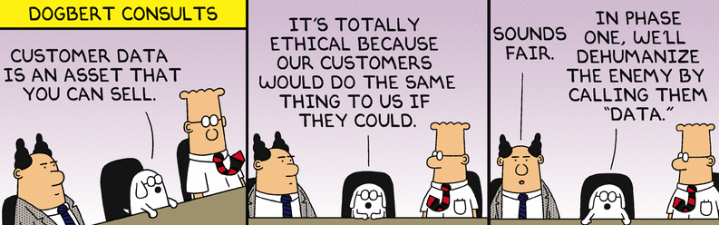
Ethics and Strategy
10/21/16

